Slide 1
How to build a better testbed
Lessons From a Decade of Network Experiments on Emulab
Fabien Hermenier
Robert Ricci
TridentCom’ 2012

Slide 2
Network testbeds
support for experiments in networked systems
highly customizable networked environments
raw access to a variety of specific hardware
design and features to match researchers’ needs

Slide 3
Testbed physical design
no extensive studies for effective testbed design
assumption-based
budget-constrained
lack of data from real experimenters
bad design decisions have consequences
prevent support for certain experiments
over-commitment on un-needed hardware
Notes:
PHYSICAL DESIGN
PHYSICAL
PHYSICAL

Slide 4
How to build better testbeds ?
careful analysis of the Utah Emulab facility usage
one of the largest testbeds
used in production since 2001
> 4 dozen testbeds worldwide with a similar designs
several alternative testbed designs
evaluation of new designs using real workload
Notes:
- Carefully analysis the usage of the testbed
Several alternative testbed design
Evaluate
Conclusions
Then the “small” points

Slide 5
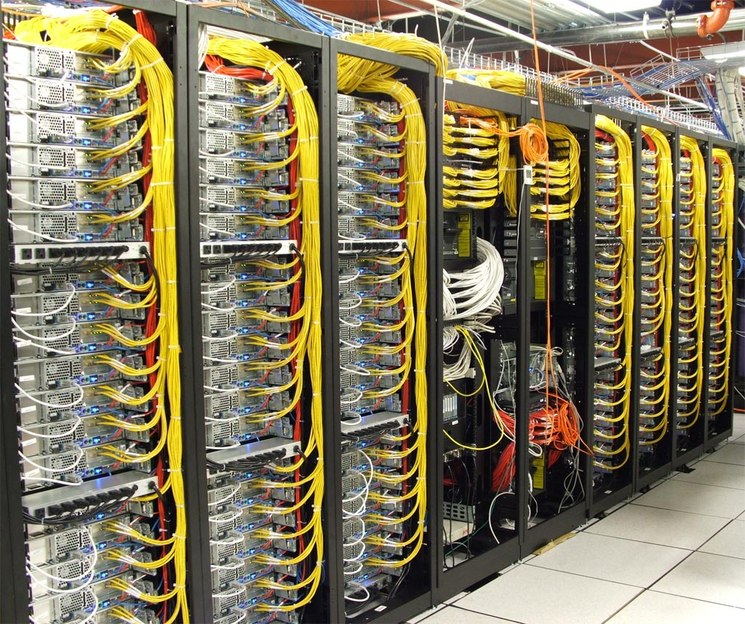
The Utah Emulab facility: not just another pretty cluster
Notes:
One it is big enough, multiple switches, bisection bandwidth dilemma

Slide 6
Virtual topology in Emulab
Lan node
Full bisection bandwidth between members
Traffic shaping
Implemented with a PC “delay node”

Slide 7
Making the virtual into reality

Slide 8
Mapping a virtual topology

Slide 9
The raw dataset
The working dataset
522 projects – 22,266 experiments – 619,504 topologies
477 projects – 13,057 experiments – 504,226 topologies
empty, non-instantiated and single node topologies
unconnected topologies
- non-cluster resources
internal projects

Slide 10
Most experiments are small
prepare with small topologies
evaluate with larger
80%
4%
multiplexable topologies
to increase acceptance rate
to deploy larger experiments

Slide 11
Attractive nodes are the bottleneck
upgrading is a necessity
to meet the demand
to support larger experiments
beauty is ephemeral
repeatability is essential
Notes:
REMOVE shade, increase dot line size
Back to colors
Recent nodes instead of pc3000/d710
Emphaze old node or the nodes I am talking about during the talk

Slide 12
Most requests use few interfaces
network interfaces are wasted
homogeneous connectivity does not reflect the reality of usage
traffic shaping is a prime feature
multiple interfaces are required

Slide 13
LANs are common, but most are small
another prime feature
LANs dominate large experiments
small LANs
a moderated usage of the interswitch bandwidth ?
90%
Notes:
Change the color of the dashes

Slide 14
Facts from experimenters data
the testbed size limits
its acceptance rate
experiments size
connectivity is overprovisioned
improved designs must provide
some nodes with multiple interfaces
non-blocking bandwidth between a few nodes

Slide 15
A cost model for testbeds
the impact of high connectivity is significant at scale
$100,000: 34 2-link nodes or 27 4-link nodes ?
$1,000,000: 370 2-link nodes or 270 4-link nodes ?
Notes:
Be more explicit about Emulab. Show the logo after to be forced to talk about Emulab
Change the colors

Slide 16
Heterogeneous node connectivity
the best nodes for a topology do not have extra links
from an ideal node connectivity distribution…
… to a testbed that minimizes link waste
+25%

Slide 17
A cost model for testbeds
small switches lead to a 30% bigger testbed …
… but the reduced bisection bandwidth between the nodes limits maximum LAN size

Slide 18
The interswitch bandwidth myth
Busted
a simulation replayed the user requests for the pc3000 nodes
97% of the topologies
interswitch links are overprovisioned
an opportunity for smaller and cheaper switches

Slide 19
Alternative for switch connectivity
interswitch bandwidth
limit LANs, experiments among switches
faster interconnect are expensive
link concentration limits direct communication
Notes:
Visual help to understand
Spend some time to explain
- Talk about the testbed, then the mapping.
1- Only the switches,
2- Add the nodes to show the concentration
Next: more nodes connected to a same switch

Slide 20
Striping links
direct communication between nodes
scalability limited by switch size
hard to mix with heterogeneous connectivity

Slide 21
Evaluating new designs
impact of relevant testbed designs on
completion time
rejection rate
the cost model as a testbed generator
the 15k topologies focusing pc3000 nodes as workload
a simulator to replay the mapping
FIFO scheduling policy
each topology runs for a day

Slide 22
Connectivity for nodes: good trade
Testbeds
$500,000 as funds
nodes with 2 or 4 links
2-link nodes | Nodes | Bandwidth | Rejections | Time (days)
0% | 130 | 1.46 Gb | 0 | 1564
60% | 148 | 1.11 Gb | 0 | 1394
90% | 161 | 30 Mb | 33 (0.2%) | 1487
Notes:
Make strong conclusions
Just talk about the context, next the title
Popup for the conclusion

Slide 23
Striping annihilates bandwidth requirements
Testbeds
148 nodes; 60% with 2-links
2 switches
Configuration | Bandwidth | Rejections | Time (days)
 | 1.11 Gb | 0 | 1394
 | 85 Mb | 0 | 996

Slide 24
Small switches, big testbed
Configuration | Cost | Nodes | Bandwidth | Rejections | Time (days)
264-ports | $498,796 | 148 | 1.11 Gb | 0 | 1394
48-ports | $498,354 | 186 | 1.06 Gb | 138 (0.9%) | 996
48-ports | $390,268 | 148 | 883 Mb | 142 (0.9%) | 1314
using large switches, support the 0.9% “hard” topologies
with 40% more time
with $108,000. $761 per “hard” topology vs. $33.5
we are the 99%

Slide 25
Conclusions
the testbed size is the bottleneck, not the network
facts lead to new design suggestions
lower connectivity
smaller switches
link striping
cost models and replays for a good insight into the testbed’s effectiveness
what to give up to support the outliers?
read the paper for more conclusions
Notes:
Split Third sub-bullet
Outliers:
for example … LAN experiment are 20 times more expensive. But experiments may be still relevant. Separated testbeds ?

Slide 26
How to Build a Better Testbed Lessons from a decade of network experiments on Emulab
Watson, I told you the problem wasn’t
the interswitch bandwidth
#!*$@ you Sherlock

Slide 27
Datacenter vs. network testbed physical design
datacenters
node centric
network as a support to maximize performance
non-explicit communications
network testbeds
network centric
explicit communication to reproduce
conservative allocation

