Slide 1
SDX: A Software-Defined Internet Exchange Points
Where We’ve Been, and Where We’re Going
Nick Feamster
Princeton University
http://sdx.cs.princeton.edu
Arpit Gupta, Rudiger Birkner, Laurent Vanbever, Marco Canini, Russ Clark, Sean Donovan, Scott Shenker, Ethan Katz-Bassett, Brandon Schlinker, Muhammad Shahbaz

Slide 2
Software Defined Networking
Changing how we design & manage networks
  Data centers, backbones, enterprises, …
But, so far, mostly inside these networks
  Network virtualization, traffic engineering, …
In this talk:
  Fundamentally change interdomain traffic delivery
  Starting at the boundaries between domains

Slide 3
Interdomain Routing is
Not Flexible Enough!
Routing only on destination IP address blocks
  (No customization of routes by application or sender)
Can only influence immediate neighbors
  (No ability to affect path selection remotely)
Indirect control over packet forwarding
(Indirect mechanisms to influence path selection)
Enables only basic packet forwarding
(Difficult to introduce new in-network services)

Slide 4
Valuable Wide-Area Services
Application-specific peering
  Route video traffic one way, and non-video another
Blocking denial-of-service traffic
  Dropping unwanted traffic further upstream
Server load balancing
  Directing client requests to different data centers
Steering through network functions
  Transcoders, scrubbers, caches, crypto, …
Inbound traffic engineering
  Splitting incoming traffic over multiple peering links

Slide 5
Enter Software-Defined Networking
Match packets on multiple header fields
(not just destination IP address)
Control entire networks with one program
(not just immediate neighbors)
Direct control over packet handling
(not indirectly via routing protocol arcana)
Perform a variety of actions on packets
(beyond basic packet forwarding)

Slide 6
Deploy SDN at Internet Exchanges
Leverage: SDN deployment even at single IXP can benefit tens to hundreds of providers
  Without providers deploying new equipment!
Innovation hotbed: Incentives to innovate, as IXPs on front line of peering disputes
Growing in numbers:
  350-400 IXPs
  ~100 new IXPs established in past few years
Notes:
Content delivery
Keep local traffic local (cost, performance, privacy/wiretapping)

Slide 7
“SDX: A Software-Defined Exchange Point” (SIGCOMM 2014)
Arpit Gupta, Nick Feamster, Laurent Vanbever, Muhammad Shahbaz, Sean Donovan, Brandon Schlinker, Scott Shenker, Russ Clark, Ethan Katz-Bassett
“An Industrial-scale Software Defined Internet Exchange Point” (NSDI 2016)
Arpit Gupta, Robert MacDavid, Rudiger Birkner, Marco Canini, Nick Feamster, Jennifer Rexford, Laurent Vanbever

Slide 8
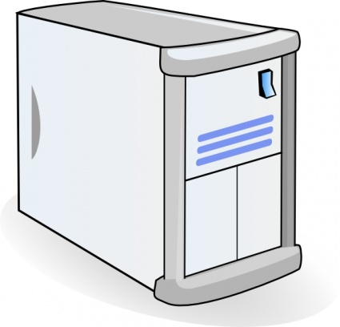
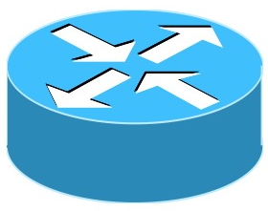

Conventional IXPs
Route Server
BGP Session
IXP
Switching Fabric
AS A Router
AS B Router
AS C Router
Notes:
So let’s first take a look as what a typical Exchange Point looks like.
Exchange points have multiple participants. Their edge routers are connected to each other using using IXP’s switching fabric.
These edge routers use the IXP’s route server to exchange BGP routes with each other.

Slide 9
SDX = SDN + IXP
SDX Controller
SDX
BGP Session
SDN Switch
AS A Router
AS B Router
AS C Router
Notes:
Compared to these IXPs, we replace the switching fabric with SDN switches and the route server with SDX controller.
This SDX controller,
subsumes router server’s behavior of exchanging BGP routes
It also takes participant’s SDN specific policies as input, combines them together and pushes down the set of OF rules.

Slide 10
SDX Architecture

Slide 11
Use Case: Prevent DDoS Attacks
Attacker
AS1 can remotely block attack traffic at SDX(es)
AS 3
SDX 1
SDX 2
AS 2
AS 1
Victim

Slide 12
SDX-based DDoS protection vs.
Traditional Defenses/Blackholing
Remote influence
  Physical connectivity to SDX not required
More specific
  Drop rules based on multiple header fields, source address, destination address, port number …
Coordinated
  Drop rules can be coordinated across multiple IXPs
Notes:
There are bunch of other applications that are also possible with SDX and you find more details about them in the paper.

Slide 13
Inbound Traffic Engineering
SDX Controller
SDX
AS A
Router
C1
C2
10.0.0.0/8
AS B Router
AS C Routers
Notes:
Now let’s consider another scenario where AS C’s policy is to receive HTTP traffic on C2.

Slide 14
Inbound Traffic Engineering
Incoming Data
C1
C2
AS A Router
AS B Router
10.0.0.0/8
AS C Routers
Incoming Traffic | Out Port | Using BGP | Using SDX
dstport = 80 | C1
Notes:
Now let’s consider another scenario where AS C’s policy is to receive HTTP traffic on C2.
Now such a fine grained policy is not possible with BGP

Slide 15
Inbound Traffic Engineering
Incoming Data
C1
C2
AS A Router
AS B Router
10.0.0.0/8
Enables fine-grained traffic engineering policies
AS C Routers
Incoming Traffic | Out Port | Using BGP | Using SDX
dstport = 80 | C1 | ? | match(dstport =80)→ fwd(C1)
Notes:
So SDX enables more direct & fine grained traffic control which is not possible in current networks.
There are bunch of other applications that are also possible with SDX and you find more details about them in the paper.

Slide 16
Experimental Evaluation
BGP RIBs & update traces from large EU IXP
511 IXP participants
96 million peering routes for 300K IP prefixes
25K BGP updates for 2-hour duration

Slide 17
SDX Design Scenarios
Unoptimized
  Data-plane policy in a single rule table
SDX paper (SIGCOMM’14)
  Encoding outbound neighbor in BGP next-hop
  Single SDX rule table (OpenFlow 1.0)
iSDX paper (in submission)
  Encoding BGP reachability in BGP next-hop
  Multi-stage SDX rule table
  Partitioning of forwarding equivalence computation

Slide 18
We Can Do This at IXP-Scale!
BGP routes and updates for large
EU IXP in a commodity hardware switch

Slide 19
What’s Happening?
Running code
  Github available from http://sdx.cs.princeton.edu
  Used in Coursera course on SDN
SDX testbeds
  Transit Portal for “in the wild” experiments
  Mininet for controller experiments
Ongoing deployment efforts
  Inter-agency exchange (NSA)
  Large European IXP

Slide 20
What’s Next?

Slide 21
New Technologies at Each Part of the Control Loop
Writing Rules and Actions
Monitoring
Analytics
More fine-grained and programmable
(INT)
Streaming capabilities, inference
Customizable
Actions
Programmable
Switches
Fully programmable data planes

Slide 22
New Technologies on the Horizon
Fully programmable data planes
  Highly programmable, protocol-independent packet processing
Better inference and decision-making, in real-time
  Scalable, high-speed, distributed stream processing

Slide 23

Fully-Programmable Data Planes:
Protocol-Independent Packet Processing
SDN Control Plane
Configuring:
Parser, tables, and control flow
Populating:
Installing and querying rules
Compiler
Parser & Table Configuration
Rule
Translator
Target Switch
Notes:
Two modes: (i) configuration and (ii) populating
Compiler configures the parser, lays out the tables (cognizant of switch resources and capabilities), and translates the rules to map to the hardware tables
The compiler could run directly on the switch (or at least some backend portion of the compiler would do so)

Slide 24
Switch Customization with P4
Parser
  Programmable parser: translate to state machine
  Fixed parser: verify the description is consistent
Control Flow
  Target-independent: table graph of dependencies
  Target-dependent: mapping to switch resources
Actions
  Specification of custom actions
  Translation of actions into underlying source code
Notes:
Parser:
Programmable parser: translate parser description into a state machine
Fixed parser: verify that the parser description is consistent with the target processor
Control program
Table graph: dependencies on processing order, opportunities for parallelism
Mapping to switch resources: physical tables, types of memory, sizes, combining tables
Rule translation
Verify rules agree with the types
Translate rules into the physical tables

Slide 25
Compiling to Target Switches
Software switches
  Directly map the table graph to switch tables
  Recompile switch with new parse/match/action
Hardware switches with RAM and TCAM
  RAM: hash table for tables with exact match
  TCAM: for tables with wildcards in the match
Switches with parallel tables
  Analyze table graph for possible concurrency

Slide 26
New Technologies at Each Part of the Control Loop
Writing Rules and Actions
Monitoring
Analytics
More fine-grained and programmable
(INT)
Streaming capabilities, inference
Customizable
Actions
Programmable
Switches
Fully programmable data planes

Slide 27
In-Band Network Telemetry (INT)
Network elements collect, report, modify state in-real time as data packets go through switch.
Writing state into packets
  (switch, in, out) tuples
  Latency
  Link Utilization
Dynamic counters based on different hash buckets
Dynamic actions based on counter thresholds
  Dynamic rule creation
  Reactive probing

Slide 28
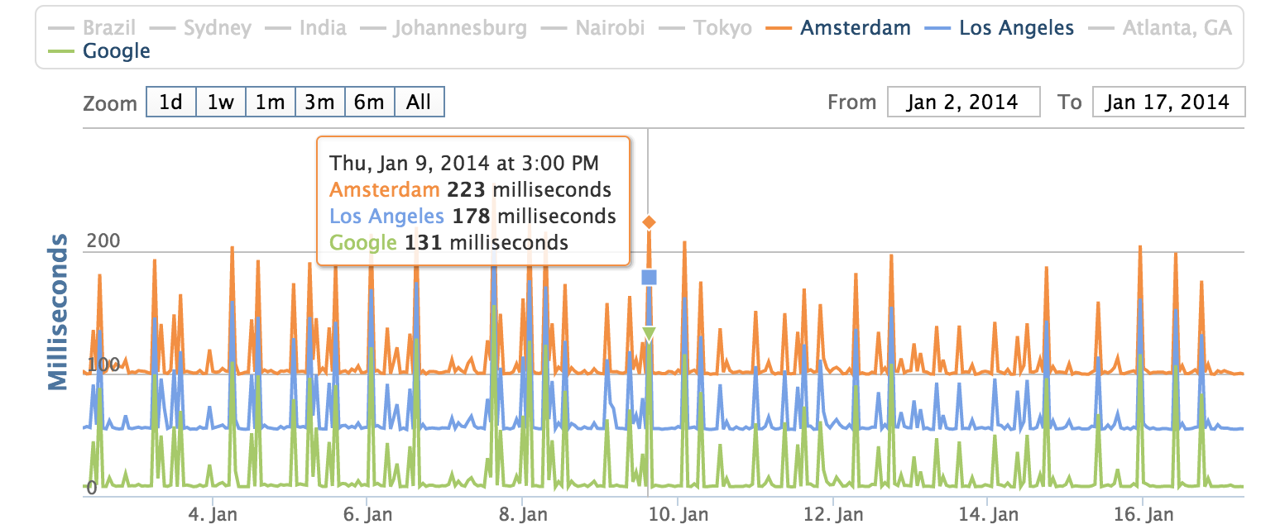
Better Monitoring #1:
Congestion Localization
Today, localizing the source of congestion is challenging, for a number of reasons
  Difficult to measure from end hosts
  ISPs have (mostly good) information, but do not want to divulge all of it (e.g., congestion to specific peers)

Slide 29
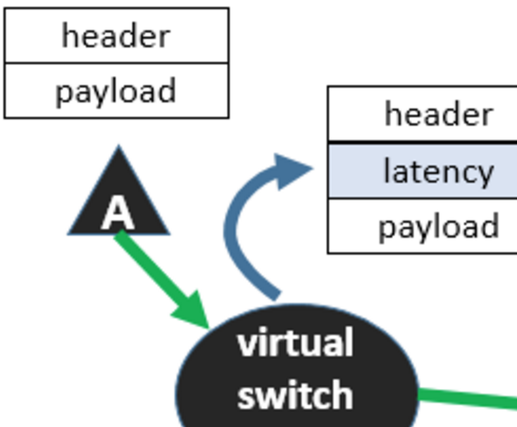
Ingress/Egress Latency With INT
Could send a train of packets with accurate timing information affixed as those packets traverse the network.
Kim et al., “In-Band Network Telemetry via Programmable Data Planes”, ACM SIGCOMM (Demo Session) August 2015.

Slide 30
Better Monitoring #2: Security
Example: DNS reflection Attacks
  Attacker spoofs source IP of DNS request to open resolver, often from many locations
  (Larger) responses go to victim
Deployment at IXP may provide useful choke point. Can monitor for:
  Spikes in lookups from IPs, for domains
  …remediation, rate limiting may be possible

Slide 31
What Else May Be Possible/Useful with INT at SDXes
In-band traceroute/topology discovery
Per-hop latency/loss/utilization recording
Active probing based on counter thresholds
Dynamic redirection of traffic flows
…

Slide 32
New Technologies at Each Part of the Control Loop
Writing Rules and Actions
Monitoring
Analytics
More fine-grained and programmable
(INT)
Streaming capabilities, inference
Customizable
Actions
Programmable
Switches
Fully programmable data planes

Slide 33
Detecting Malicious ASes Through Rewiring
Snapshots taken 3 months apart
Malicious ASes tend to change connectivity more aggressively than legit ASes
Konte et al. “ASwatch: A Reputation System to Expose Bulletproof Hosting ASes”,
ACM SIGCOMM, August 2015.

Slide 34
BGP routing dynamics
Advertise
52.34.21.0/24
Withdraw
52.34.21.0/24
Malicious activity
Malicious AS
Malicious AS
Malicious AS
Malicious ASes routing dynamics are driven by illicit operations e.g. short-lived announcements to perform malicious actions
In contrast legit ASes dynamics are driven by policy changes, traffic engineering decisions

Slide 35
Fragmentation and churn of advertised prefixes
109.196.143/24
62.123.14/24
109.196.141/24
85.124.23/16
42.10.14/23
131.124.14/23
92.112.112/23
52.34.21/24
31.145.14/24
Malicious AS
Malicious AS
Malicious ASes rotate their advertised prefixes, e.g. to avoid evasion, blacklisting
Advertise large number of non-contiguous prefixes

Slide 36
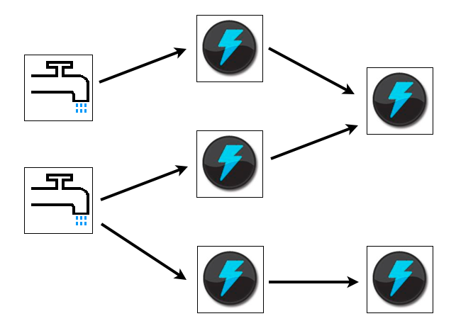
Idea: Real-Time Routing Decisions Based on Complex Inputs
Cassandra RIBs
Kafka Spouts
Input
Local
Output
NetFlow
Records
BGP Update
FetchPath
BestPath
UpdatePath
UpdateDP
Storm Bolts
IPS Alerts
Process 100K BGP update burst within 50 ms

Slide 37
SDX Platform
Running code
  Github available from http://sdx.cs.princeton.edu
  Used in Coursera course on SDN
SDX testbeds
  Transit Portal for “in the wild” experiments
  Mininet for controller experiments
Ongoing deployment efforts
  Inter-agency exchange (NSA)
  Large European IXP
Notes:
So far we have developed a prototype of SDX. We have two different types of SDX testbeds. One uses Transit portal to bring live traffic to the SDX switch and the other uses virtual containers in Mininet to emulate edge routers. We also have a demo after this session which shows how we develop two applications using SDX and how they interoperate with each other.
You can find more details about this testbed from our github repo. We also have instructions for users to get started with SDX and try out their own new applications.

Slide 38
Conclusion
The Internet is changing
  New challenges for content delivery
  Increasing importance of IXPs
SDN can speed innovation
  New capabilities and abstractions
Ongoing
  Operational deployments
Looking forward…
  Protocol-independent switches
  High-rate stream processing

